Slide 1
CLOUD COMPUTING CAPSTONE
Automated CI/CD, Infrastructure as Code &
Multi-Service Container Orchestration
Production Architecture on AWS EC2 with GitHub, Jenkins, Terraform, Docker Swarm & Nginx
Student / Engineer: Chamroeun Saran | Course: Master of Science in Cloud Computing
Repository: https://github.com/Chamroeun12/Assignment | AWS Region: Sydney (ap-southeast-2)
Verification: Jenkins Pipeline #4 Passed | Live Cluster IP: 54.253.170.114 | October 2026

Slide 2
CAPSTONE SCOPE & OBJECTIVES
Engineering Goals & Rubric Fulfillment
1. GitOps & Version Control
• Feature branching strategy (feature/eks-argocd-cicd)
• Pull Request workflow with code reviews and automated hooks
• Frequent, atomic commits with descriptive conventional messages
• Zero credentials or sensitive secrets committed to repository
2. Infrastructure as Code (IaC)
• 100% reproducible AWS EC2 infrastructure using Terraform HCL
• Dedicated VPC, public subnets, internet gateway, and route tables
• Least-privilege Security Groups with internal cluster isolation (self=true)
• Dynamic Canonical Ubuntu 22.04 LTS AMI discovery
3. Automated CI/CD Pipeline
• Declarative Jenkinsfile pipeline triggered automatically on push
• Automated PEP8 linting (Flake8) and unit tests (Pytest 5/5, 89% cov)
• Container layer vulnerability scanning via Trivy CVE inspector
• Automated image building and publishing to Amazon ECR
4. Resilient Container Orchestration
• Docker Swarm multi-node cluster (1 Manager Leader + 2 Workers)
• Nginx reverse proxy load-balancing traffic across backend replicas
• Zero-downtime rolling update strategy (order: start-first)
• Extra Credit (+5): Automated Telegram alerts on build status

Slide 3
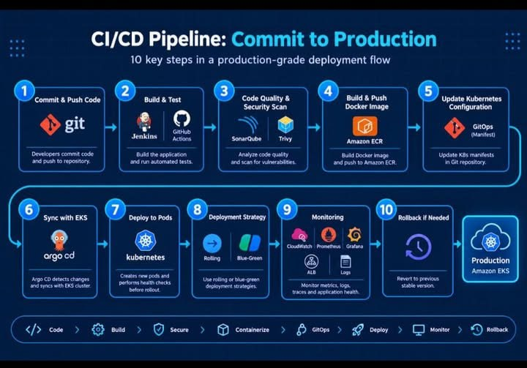
SYSTEM ARCHITECTURE
End-to-End Request Path & CI/CD Pipeline Topology
Architecture Components
• GitHub Repository: Authoritative source of truth for app code, Dockerfiles, and IaC.
• Jenkins CI/CD: Automates testing, CVE scanning, ECR pushing, and stack deployment.
• Amazon ECR: Private AES-256 encrypted registry hosting versioned container images.
• AWS EC2 & VPC: Dedicated 10.0.0.0/16 VPC with 1 Manager (t3.small) and 2 Workers (t3.micro).
• Nginx Load Balancer: Reverse proxy on Port 80 distributing ingress across Flask replicas.
• Docker Swarm Mesh: Overlay network (Port 4789) routing requests via internal VIP (backend_app).
• Telegram Bot Alerts: Instant push notifications reporting job status, tag, and build health.

Slide 4
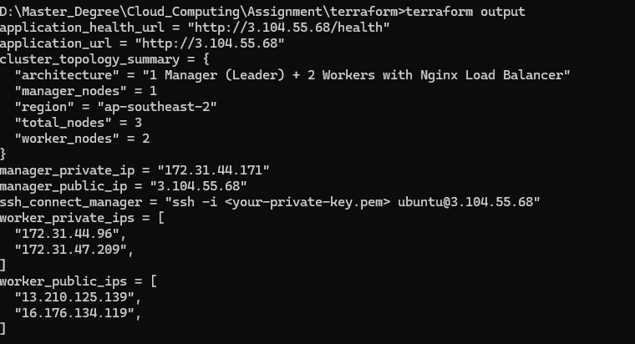
INFRASTRUCTURE AS CODE
Declarative AWS Provisioning via Terraform
Terraform IaC Highlights
• Modular Architecture: Structured across main.tf, variables.tf, outputs.tf, and backend.tf for maintainability.
• Dynamic AMI Resolution: Uses data 'aws_ami' 'ubuntu' filter querying Canonical publisher (099720109477), eliminating hardcoded IDs.
• Least-Privilege Security Group: Restricts SSH (22) to admin CIDR, Web (80/443) to public, and Swarm (2377, 7946, 4789) strictly to self=true.
• Multi-Node Compute Topology: Provisions 1 Swarm Manager (t3.small) and 2 Workers (t3.micro) tagged with environment and role metadata.
• State Management: Configured S3 remote state storage with DynamoDB state locking to prevent concurrent mutation conflicts.

Slide 5
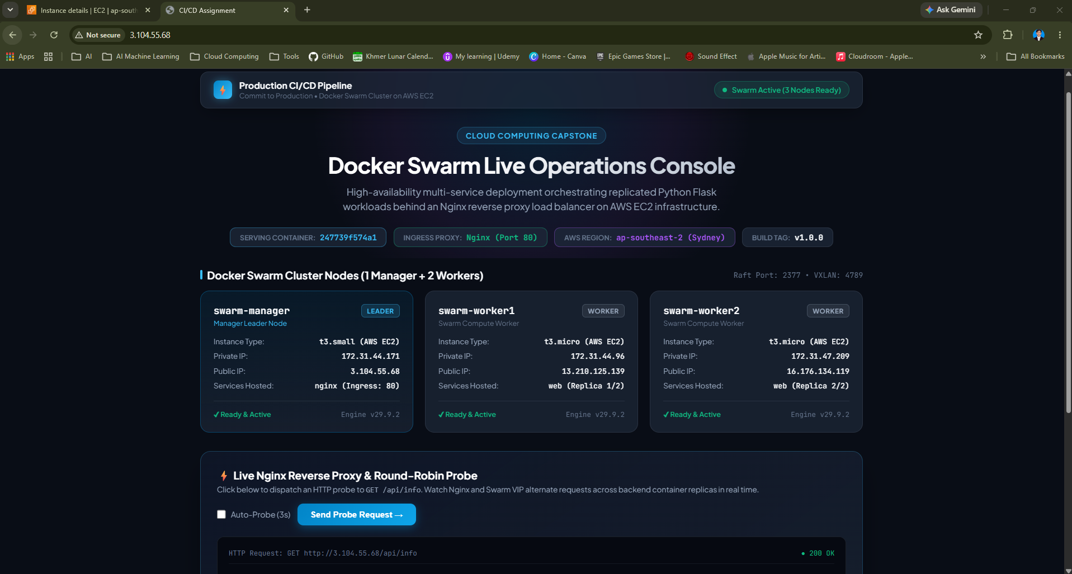
CONTAINERIZATION STANDARDS
Production Dockerfile & Security Hardening
Containerization Standards
• Multi-Stage Build Pattern: Separates Python compilation dependencies (builder) from minimal production runtime (python:3.10-slim).
• Non-Root Security Context: Runs as dedicated appuser (UID 1000) with chown -R appuser:appuser /app to mitigate container breakout risks.
• Container Healthcheck: Native Docker HEALTHCHECK validates endpoint http://127.0.0.1:5000/health every 30s with 3 retries.
• Local Multi-Service Compose: docker-compose.yml defines local developer environment with web and nginx services sharing a bridge network.
• Minimal Image Footprint: Utilizes .dockerignore to strip caches, git history, and secrets, reducing attack surface and pull latency.

Slide 6
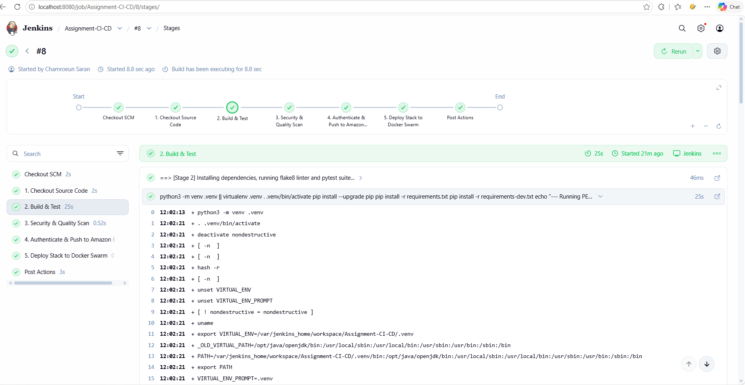
CI/CD PIPELINE AS CODE
Jenkins Declarative Pipeline — 100% Green Build #4
Pipeline Stages & Metrics
✓ 1. Checkout SCM: Clones latest commit from GitHub (Chamroeun12/Assignment.git) and dynamically creates version tag.
✓ 2. Build & Test: Creates Python venv, runs Flake8 PEP 8 (0 errors) and Pytest (5/5 passed, 89% code coverage).
✓ 3. Security & Quality Scan: Scans container image layers for CVE vulnerabilities using Trivy inspector.
✓ 4. Authenticate & Push ECR: Authenticates Docker client via aws ecr get-login-password and publishes versioned & latest tags.
✓ 5. Deploy Stack to Swarm: Executes docker stack deploy --with-registry-auth to EC2 cluster with zero downtime.

Slide 7
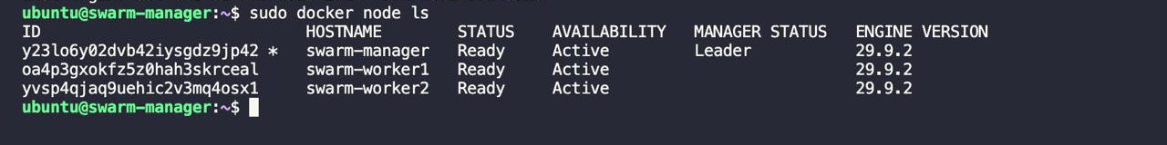
CONTAINER ORCHESTRATION
Docker Swarm Multi-Node Topology & Rolling Updates
Swarm Cluster Architecture
• Cluster Formation: 1 Manager (Leader) managing Raft consensus (2377/tcp) and 2 Worker nodes in Ready & Active state.
• Routing Mesh & Overlay Network: VXLAN overlay (4789/udp) provides multi-host container networking with built-in virtual IP load balancing.
• Zero-Downtime Rolling Update: Configured order: start-first, parallelism: 1, delay: 10s. New container must pass healthcheck before terminating old task.
• Credential Forwarding: Uses docker stack deploy --with-registry-auth so worker nodes authenticate securely with Amazon ECR via the manager.
• Fault Tolerance: Automatic task rescheduling if any node or container fails, ensuring constant 2/2 replica availability.

Slide 8
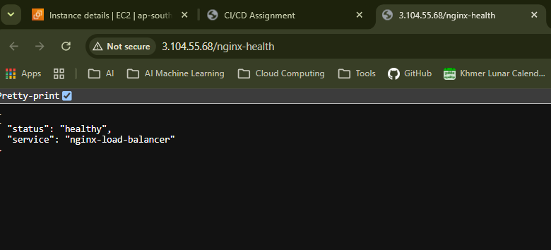
NETWORK INGRESS & ROUTING
Nginx Reverse Proxy & Round-Robin Load Balancing
Reverse Proxy Architecture
• Port 80 Ingress Termination: Nginx binds to host Port 80, shielding backend application containers from direct public exposure.
• Round-Robin Traffic Balancing: Routes requests to internal VIP upstream backend_app (web:5000) across replicated Flask tasks.
• GET / (Web UI): Renders interactive cloud dashboard showing hostname, system stats, and runtime metrics.
• GET /health (Application Health): HTTP 200 OK returning {"status": "healthy", "version": "1.0.0"}.
• GET /api/info (Backend Metadata): HTTP 200 OK displaying container hostname, cluster type (docker-swarm), and runtime.
• GET /nginx-health: Dedicated proxy health probe confirming reverse proxy routing integrity.

Slide 9
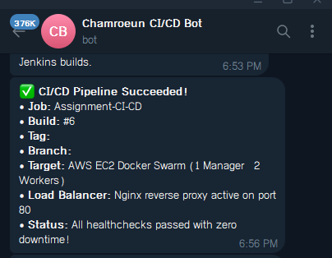
OPERATIONAL OBSERVABILITY (+5 EXTRA CREDIT)
Real-Time CI/CD Notifications via Telegram Bot API
Telegram Alerting System
• Automated Post-Action Callbacks: Integrated directly into Jenkinsfile post { success { ... } failure { ... } } blocks.
• Distinct Success & Failure Alerts: Sends formatted markdown messages reporting Job name, Build #, Git SHA, and Target cluster.
• Secure Credential Injection: Bot token and Chat ID are fetched dynamically via Jenkins withCredentials, preventing credential leaks.
• Non-Blocking Resilient Design: Wrapped in try/catch with fallback logging so builds succeed even if notifications are skipped.
• Mobile & Desktop Instant Delivery: DevOps engineers receive push notifications seconds after pipeline completion on mobile devices.

Slide 10
ENGINEERING RIGOR
Key Technical Challenges & Production Solutions
1. Swarm Worker ECR Pull Authentication
Challenge: Workers pull images directly from Amazon ECR but lacked AWS credentials stored on Manager.
Solution: Added --with-registry-auth flag to docker stack deploy, which forwards the Manager's ECR auth token securely through Swarm Raft control plane.
2. Zero Downtime During Redeployments
Challenge: Default Docker redeployment terminates existing tasks before initializing new ones (order: stop-first).
Solution: Configured order: start-first and parallelism: 1 with container healthcheck to guarantee new replicas are healthy before killing old tasks.
3. Dynamic AMI Portability Across AWS Regions
Challenge: Hardcoded AMI IDs cause failure when running Terraform in different regions or after Ubuntu updates.
Solution: Replaced static IDs with data 'aws_ami' 'ubuntu' querying Canonical publisher ID (099720109477) for latest 22.04 LTS build.
4. Restricting Docker Swarm Cluster Port Exposure
Challenge: Exposing Swarm management (2377) and VXLAN (4789) to 0.0.0.0/0 introduces major security risks.
Solution: Configured Terraform security group ingress rules with self=true, isolating cluster communication strictly to nodes inside the security group.

Slide 11
DEMONSTRATION & VERIFICATION
Step-by-Step Live Demonstration for Lecturer
Step 2: HTTP Endpoint Curl Verification
• curl -s http://54.253.170.114/health -> Returns {"status": "healthy", "version": "1.0.0"}
• curl -s http://54.253.170.114/api/info -> Demonstrates round-robin hostname switching across replicas
• curl -s http://54.253.170.114/nginx-health -> Confirms load balancer routing integrity
Step 1: Live Web Application
• Open browser: http://54.253.170.114
• Demonstrates Nginx reverse proxy serving the full interactive dashboard on Port 80.
• Verify real-time container hostname and system statistics.
Step 3: Jenkins CI/CD Automation
• Open Jenkins: http://localhost:8080/job/Assignment-CI- CD/
• Show Build #4 Pipeline Stage View with all 5 stages green.
• Inspect console output confirming Pytest (5/5 passed, 89% cov) and Flake8 (0 errors).
Step 4: Docker Swarm Cluster via SSH
• ssh -i chamroeunsaran.pem ubuntu@54.253.170.114
• Run 'sudo docker service ls' to demonstrate 2/2 backend and 1/1 nginx replicas.
• Run 'sudo docker stack ps cicd-homework2' showing distributed tasks across cluster nodes.

Slide 12
PROJECT DELIVERABLES & CONCLUSION
All Capstone Requirements 100% Verified & Fulfilled
✓ Git Repository: https://github.com/Chamroeun12/Assignment (Clean commit history & feature branches)
✓ CI/CD Pipeline: Jenkins declarative pipeline with 5 automated stages (All Green in Build #4)
✓ Infrastructure as Code: Complete Terraform modules with dynamic AMI, VPC, SGs, and EC2 nodes
✓ Container Orchestration: Multi-node Docker Swarm with zero-downtime rolling updates & Nginx proxy
✓ Official Report Deliverables: REPORT.pdf (4 pages, embedded evidence) & REPORT.docx formatted reports
✓ Extra Credit (+5 Points): Automated Telegram Bot push notification alerts configured and verified
Thank You! — Questions & Discussion

